Slide 1
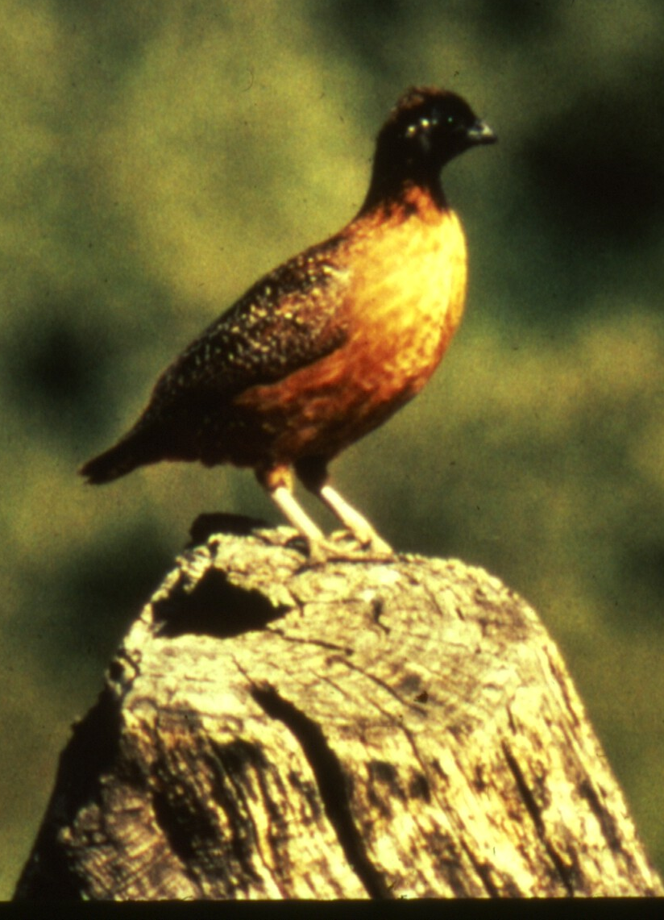
Habitat Suitability Index Models for Masked Bobwhite
Dominic D LaRoche¹ and Courtney J Conway²
¹ University of Arizona, School of Natural Resources
² USGS Idaho Cooperative Fish and Wildlife Research Unit
Photo by Roy Tomlinson

Slide 2
Outline
Review
Products
Interpretation
Next Steps

Slide 3
Habitat Suitability Index Models (HSI)
Developed by the USFWS in 1981 to better evaluate fish and wildlife habitat needs
Contain quantitative relationships between key environmental variables and habitat suitability
Typically reference numerous experts/ literature sources and consolidate information
Typically used as hypotheses of species-habitat relationships
Serve as a basis for improved decision making
Increase understanding of habitat relationships through testing and refinement
Can be used to generate maps of ranked habitat units

Slide 4
Application to Masked Bobwhite
A habitat suitability model will be valuable for masked bobwhite recovery
Can inform the search for existing masked bobwhite populations
Can help identify the best places to release captive bred bobwhites
Can inform land management decisions
Notes:
Change ‘will be’ to ‘could be’

Slide 5
Expert Opinion
Expert opinion has been used to develop models for many species
Best used for species where data is limited (Pearce et al. 2001)
Frequently used for habitat suitability models (Johnson and Gillingham 2004)

Slide 6
Project Goals
Summarize and synthesize important habitat features
Quantify the relationships between important habitat features and habitat suitability for masked bobwhite
Translate the various bivariate relationships between habitat features and masked bobwhite into a suite of mathematical habitat suitability models
Notes:
Stress why we need to get to step 2.

Slide 7
Methods: Objective 1 Identify Important variables
Identified and contacted 12 species experts
Phone conversations with 9
In-person interviews with 7 species experts

Slide 8
Methods: Objective 1 Identify Important Variables
Asked three main questions about habitat:
What has prevented masked bobwhite from persisting or recovering?
What are the most important habitat characteristics for masked bobwhite?
How does season (time of year) affect these variables and their relative importance?

Slide 9
Results: Objective 1 Identify Important Variables
Identified 22 separate issues affecting masked bobwhite recovery
20 were related habitat or environment
Sent out a separate survey so experts could rank these in order of importance

Slide 10
Results: Objective 1 Identify Important Variables
 | Avian Predators | Winter Food | Invasive Plant spp | Climate | Woodland /Grassland Edges | Thermal Refugia | Brush and Shrub Cover | Vegetation Height (herbaceous) | Leguminous Shrubs | Vegetation Structural Diversity | Arthropod Diversity and Abundance | Bare Ground | Grass Cover | Tree Cover | Mammalian Predators | Herbaceous Species Diversity | Forb Cover
Expert 1 | 1 |  |  |  |  |  |  |  |  |  |  |  |  | 1 | 2
Expert 2 |  | 1 | 2 | 3 |  |  |  |  | 1 |  | 4 |  |  |  |  | 4
Expert 3 |  |  |  | 1 |  | 2 | 3 |  |  | 5 |  | 4 | 5 | 2 |  | 6 | 3
Expert 4 | 8 | 3 | 7 | 6 | 2 |  | 3 | 9 | 3 |  |  | 4 | 1 |  | 8 |  | 5
Expert 5 | 4 | 1 |  |  | 5 | 3 | 2 |  |  | 5 |  |  | 6 | 6 | 4 |  | 6
Expert 6 |  | 6 |  |  | 4 |  | 3 |  |  | 1 | 6 |  | 4 | 5 |  | 2 | 6
Expert 7 |  |  | 1 | 1 | 3 |  | 5 |  | 2 | 3 |  | 4 | 3 | 6 |  | 1 | 2
Expert 8 |  |  | 16 | 1 |  |  | 6 |  | 3 |  |  |  | 5 |  |  | 2 | 4
Expert 9 |  |  |  | 1
 | Very Important and Beneficial |  |  |  |  |  |  |  | Very Important and Detrimental
Notes:
Here is a heat map of the 16 variables after removing non-habitat variables but including ultimate processes.

Slide 11
Results: Objective 1 Identify Important Variables
Some strong agreement on variables
 | Avian Predators | Winter Food | Invasive Plant spp | Climate | Woodland /Grassland Edges | Thermal Refugia | Brush and Shrub Cover | Vegetation Height (herbaceous) | Leguminous Shrubs | Vegetation Structural Diversity | Arthropod Diversity and Abundance | Bare Ground | Grass Cover | Tree Cover | Mammalian Predators | Herbaceous Species Diversity | Forb Cover
Expert 1 | 1 |  |  |  |  |  |  |  |  |  |  |  |  | 1 | 2
Expert 2 |  | 1 | 2 | 3 |  |  |  |  | 1 |  | 4 |  |  |  |  | 4
Expert 3 |  |  |  | 1 |  | 2 | 3 |  |  | 5 |  | 4 | 5 | 2 |  | 6 | 3
Expert 4 | 8 | 3 | 7 | 6 | 2 |  | 3 | 9 | 3 |  |  | 4 | 1 |  | 8 |  | 5
Expert 5 | 4 | 1 |  |  | 5 | 3 | 2 |  |  | 5 |  |  | 6 | 6 | 4 |  | 6
Expert 6 |  | 6 |  |  | 4 |  | 3 |  |  | 1 | 6 |  | 4 | 5 |  | 2 | 6
Expert 7 |  |  | 1 | 1 | 3 |  | 5 |  | 2 | 3 |  | 4 | 3 | 6 |  | 1 | 2
Expert 8 |  |  | 16 | 1 |  |  | 6 |  | 3 |  |  |  | 5 |  |  | 2 | 4
Expert 9 |  |  |  | 1
 | Very Important and Beneficial |  |  |  |  |  |  |  | Very Important and Detrimental
Notes:
As you can see, some variables had strong agreement between experts.

Slide 12
Results: Objective 1 Identify Important Variables
Some modest agreement on variables
 | Avian Predators | Winter Food | Invasive Plant spp | Climate | Woodland /Grassland Edges | Thermal Refugia | Brush and Shrub Cover | Vegetation Height (herbaceous) | Leguminous Shrubs | Vegetation Structural Diversity | Arthropod Diversity and Abundance | Bare Ground | Grass Cover | Tree Cover | Mammalian Predators | Herbaceous Species Diversity | Forb Cover
Expert 1 | 1 |  |  |  |  |  |  |  |  |  |  |  |  | 1 | 2
Expert 2 |  | 1 | 2 | 3 |  |  |  |  | 1 |  | 4 |  |  |  |  | 4
Expert 3 |  |  |  | 1 |  | 2 | 3 |  |  | 5 |  | 4 | 5 | 2 |  | 6 | 3
Expert 4 | 8 | 3 | 7 | 6 | 2 |  | 3 | 9 | 3 |  |  | 4 | 1 |  | 8 |  | 5
Expert 5 | 4 | 1 |  |  | 5 | 3 | 2 |  |  | 5 |  |  | 6 | 6 | 4 |  | 6
Expert 6 |  | 6 |  |  | 4 |  | 3 |  |  | 1 | 6 |  | 4 | 5 |  | 2 | 6
Expert 7 |  |  | 1 | 1 | 3 |  | 5 |  | 2 | 3 |  | 4 | 3 | 6 |  | 1 | 2
Expert 8 |  |  | 16 | 1 |  |  | 6 |  | 3 |  |  |  | 5 |  |  | 2 | 4
Expert 9 |  |  |  | 1
 | Very Important and Beneficial |  |  |  |  |  |  |  | Very Important and Detrimental
Notes:
Others had moderate agreement

Slide 13
Results: Objective 1 Identify Important Variables
Some disagreement on variables
 | Avian Predators | Winter Food | Invasive Plant spp | Climate | Woodland /Grassland Edges | Thermal Refugia | Brush and Shrub Cover | Vegetation Height (herbaceous) | Leguminous Shrubs | Vegetation Structural Diversity | Arthropod Diversity and Abundance | Bare Ground | Grass Cover | Tree Cover | Mammalian Predators | Herbaceous Species Diversity | Forb Cover
Expert 1 | 1 |  |  |  |  |  |  |  |  |  |  |  |  | 1 | 2
Expert 2 |  | 1 | 2 | 3 |  |  |  |  | 1 |  | 4 |  |  |  |  | 4
Expert 3 |  |  |  | 1 |  | 2 | 3 |  |  | 5 |  | 4 | 5 | 2 |  | 6 | 3
Expert 4 | 8 | 3 | 7 | 6 | 2 |  | 3 | 9 | 3 |  |  | 4 | 1 |  | 8 |  | 5
Expert 5 | 4 | 1 |  |  | 5 | 3 | 2 |  |  | 5 |  |  | 6 | 6 | 4 |  | 6
Expert 6 |  | 6 |  |  | 4 |  | 3 |  |  | 1 | 6 |  | 4 | 5 |  | 2 | 6
Expert 7 |  |  | 1 | 1 | 3 |  | 5 |  | 2 | 3 |  | 4 | 3 | 6 |  | 1 | 2
Expert 8 |  |  | 16 | 1 |  |  | 6 |  | 3 |  |  |  | 5 |  |  | 2 | 4
Expert 9 |  |  |  | 1
 | Very Important and Beneficial |  |  |  |  |  |  |  | Very Important and Detrimental
Notes:
And still others had disagreement. As a side note this information may be useful in directing future research to clarify these inconsistencies and settle some of these disputes.

Slide 14
Results: Objective 1 Identify Important Variables
Developed a weighted list of variables to guide management
Habitat Variable | Rank | Weight⁻¹
Climate | 1 | -2.166667
Leguminous Shrubs | 2 | 2.25
Thermal Refugia | 3 | 2.5
Winter Food | 4 | 2.75
Herbaceous Species Diversity | 5 | 3
Woodland /Grassland Edges | 6 | 3.5
Vegetation Structural Diversity | 7 | 3.5
Brush and Shrub Cover | 8 | 3.666667
Bare Ground | 9 | 4
Grass Cover | 10 | 4
Tree Cover | 11 | 4
Avian Predators | 12 | -4.333333
Forb Cover | 13 | 4.333333
Mammalian Predators | 14 | -4.666667
Arthropod Diversity and Abundance | 15 | 5
Invasive Plant spp | 16 | 6.5
Vegetation Height (herbaceous) | 17 | 9

Slide 15
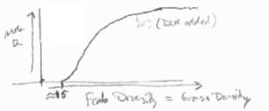

Methods: Objective 2 Quantify Species-Habitat Relationships
Conducted second round of interviews to quantify explicit relationships between habitat variables and habitat suitability
Six experts participated in second round of interviews
Asked experts to draw hypothesized relationships and extrapolated relationships from the literature wherever possible
Forb Diversity
$$f\left(x\right)= …$$
Created mathematical functions to closely approximate drawings

Slide 16
Results: Objective 2 Quantify Species-Habitat Relationships
Quantified the hypothesized relationship between 22 habitat variables and habitat suitability for masked bobwhites
Relationships varied by season, geographic location, and expert for a total of 90 individual hypothesized relationships
Computed mean suitability relationships for each season and geographic location for each variable.
Notes:
Add plots to illustrate

Slide 17
Objective 3 Develop Habitat Suitability Index Models
Used information from interviews and suitability relationships to create HSI models
Created 6 HSI models from experts and 1 from the literature
Sent completed models to each expert for final approval

Slide 18
Additional Work
Identified a need to create actionable information from the large number of hypothesized HSI models
Quantify Uncertainty
Uncertainty of habitat-suitability relationships
Can be used to identify habitat-suitability relationships with low or high uncertainty
Focus research on areas of highest uncertainty and importance
Uncertainty of Model Structures
Can determine the importance of model structure
Simulations

Slide 19
Understanding Uncertainty
Understanding the uncertainty is important for making management decisions
How much uncertainty is associated with each suitability estimate
What is the source of the uncertainty?
What is the impact of the uncertainty on recovery?
How can we reduce the uncertainty?

Slide 20
Understanding Uncertainty
Potential sources of uncertainty:
Variable selection uncertainty
The nature of the suitability functions
The structure of the model
Relationships between variables
Importance of variables relative to one another
Latent variables (Food, Reproduction, etc.)
Measurement error of model inputs

Slide 21
Understanding Uncertainty
Potential sources of uncertainty:
Variable selection uncertainty
The nature of the suitability functions
The structure of the model
Relationships between variables
Importance of variables relative to one another
Latent variables (Food, Reproduction, etc.)
Measurement error of model inputs

Slide 22
Understanding Uncertainty
Potential sources of uncertainty:
Variable selection uncertainty
The nature of the suitability functions
The structure of the model
Relationships between variables
Importance of variables relative to one another
Latent variables (Food, Reproduction, etc.)
Measurement error of model inputs

Slide 23
Estimating Uncertainty
Uncertainty of Suitability Relationships:
We used the complete set of expert opinion to quantify uncertainty for each suitability function
Assumes the “true” relationship is spanned by the set of expert opinions
Assumes experts at the extreme range of the function are either over or underestimating the true relationship
Provides a tool for understanding where experts agree or disagree

Slide 24
An Example
Uncertainty of Proportion Forb Cover
Diversity of Opinions
Average Suitability
Uncertainty

Slide 25
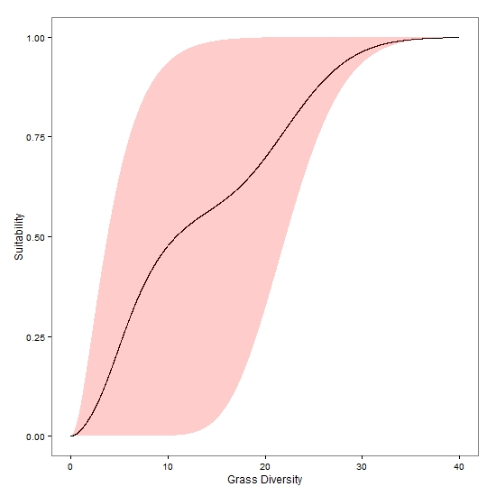
Another Example
Uncertainty of Grass Diversity
Diversity of Opinions
Average Suitability
Uncertainty

Slide 26
What does this tell us?
There is no consensus on the best amount of grass cover

Slide 27
What does this tell us?
There is no consensus on the best amount of grass cover
The mean is bi-modal

Slide 28
What does this tell us?
There is no consensus on the best amount of grass cover
The mean is bi-modal
There is a large amount of uncertainty

Slide 29
What does this tell us?
There is no consensus on the best amount of grass cover
The mean is bi-modal
There is a large amount of uncertainty
There is consensus on an optimal number of grass species

Slide 30
What does this tell us?
There is no consensus on the best amount of grass cover
The mean is bi-modal
There is a large amount of uncertainty
There is consensus on an optimal number of grass species
The mean is consistent, i.e. one can compare two sites to see which is better

Slide 31
What does this tell us?
There is no consensus on the best amount of grass cover
The mean is bi-modal
There is a large amount of uncertainty
There is consensus on an optimal number of grass species
The mean is consistent
There is a less uncertainty

Slide 32
What does this tell us?
We can compare uncertainty between variables by numerically integrating the area of the uncertainty estimate
Three steps:
Standardize the units among variables
Integrate
Rank Variables based on uncertainty

Slide 33
Uncertainty of Suitability Functions
Habitat Variable | Uncertainty | Habitat Variable | Uncertainty
Forb Cover: AZ, Summer | 988.1
Forb Cover: AZ, Winter | 988.1 | Proportion of Bare Ground | 630.2
Forb Cover: MX, Winter | 986.7 | Tree Cover: AZ, Uplands, Winter | 603.7
Forb Cover: MX, Summer | 986.7 | Tree Cover: MX, Arroyos, Winter | 586.0
Perennial Grass Cover, MX | 974.6 | Grass Height for Cover | 557.6
Annual Grass Cover, MX | 974.5 | Annual Grass Diversity, MX | 550.0
Perennial Grass Cover, AZ | 956.9 | Annual Grass Diversity, AZ | 549.9
Annual Grass Cover, AZ | 956.8 | Forb Height in the Spring | 530.6
Forb Diversity | 787.5 | Tree Cover: MX, Arroyos, Summer | 527.7
Shrub Cover: MX, Summer | 681.5 | Perennial Grass Diversity, MX | 527.3
Shrub Cover: MX, Winter | 681.5 | Perennial Grass Diversity, AZ | 524.9
Forb Height in the Fall | 680.6 | Tree Cover: MX, Uplands, Summer | 523.7
Shrub Cover: AZ, Summer | 669.5 | Tree Cover: AZ, Arroyos, Summer | 522.2
Tree Cover: MX, Uplands, Winter | 649.7 | Grass Height for Nesting | 511.8
Shrub Cover: AZ, Winter | 635.0 | Tree Cover: AZ, Uplands, Summer | 480.9
Tree Cover: AZ, Arroyos, Winter | 632.0 | Shrub Height | 127.2

Slide 34

Methods: Simulations and Uncertainty of Model Structure
We used simulations to determine the uncertainty associated with model structure
Simulated suitability scores for 3“habitats”
Simulated variable scores not variable values
Scores were simulated as a symmetric beta process:
$$S_{i}\left(x_{j}\right)=\frac{{x_{j}}^{4}{(1−x_{j})}^{4}}{B\left(5,5\right)}, and$$
$$E\left[\sum_{j=1}^{p}{S_{i}\left(x_{j}\right)}\right]=0.5 ∀ S_{i,}$$
This allowed us to know what the mean score should be for any linear combination of the variables

Slide 35
Methods: Simulations and Uncertainty of Model Structure
For each of the simulations we compared:
Overall suitability
Variation in suitability
Range of suitability values

Slide 36
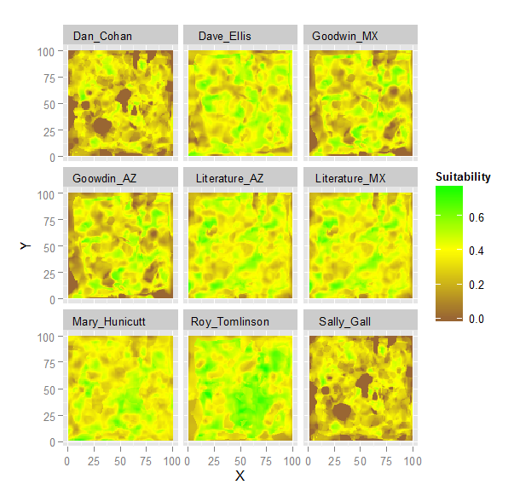
Results: Simulations and Uncertainty of Model Structure

Slide 37
Results: Simulations and Uncertainty of Model Structure
 | Simulation 1 |  |  |  | Simulation 2 |  |  |  | Simulation 3 |  |  |  | Average
Author | Mean | Min | Max | Variance | Mean | Min | Max | Variance | Mean | Min | Max | Variance | Mean | Range | Variance
Dan Cohan | 0.237 | 0.000 | 0.672 | 0.018 | 0.251 | 0.000 | 0.646 | 0.020 | 0.220 | 0.000 | 0.541 | 0.017 | 0.236 | 0.620 | 0.018
Dave Ellis | 0.399 | 0.000 | 0.709 | 0.013 | 0.380 | 0.000 | 0.673 | 0.013 | 0.362 | 0.000 | 0.756 | 0.012 | 0.380 | 0.713 | 0.013
J. Goodwin (MX) | 0.323 | 0.000 | 0.767 | 0.018 | 0.317 | 0.000 | 0.705 | 0.021 | 0.286 | 0.000 | 0.662 | 0.017 | 0.309 | 0.711 | 0.019
J. Goodwin (AZ) | 0.323 | 0.000 | 0.767 | 0.018 | 0.317 | 0.000 | 0.705 | 0.021 | 0.286 | 0.000 | 0.662 | 0.017 | 0.309 | 0.711 | 0.019
Mary Hunnicutt | 0.358 | 0.128 | 0.627 | 0.005 | 0.383 | 0.081 | 0.730 | 0.009 | 0.340 | 0.074 | 0.641 | 0.007 | 0.360 | 0.572 | 0.007
Sally Gall | 0.227 | 0.000 | 0.672 | 0.016 | 0.243 | 0.000 | 0.646 | 0.019 | 0.212 | 0.000 | 0.538 | 0.015 | 0.227 | 0.619 | 0.017
Roy Tomlinson | 0.474 | 0.129 | 0.783 | 0.008 | 0.441 | 0.113 | 0.769 | 0.015 | 0.418 | 0.108 | 0.733 | 0.010 | 0.444 | 0.645 | 0.011
Literature (AZ) | 0.386 | 0.000 | 0.776 | 0.013 | 0.388 | 0.015 | 0.712 | 0.012 | 0.346 | 0.074 | 0.659 | 0.011 | 0.373 | 0.686 | 0.012
Literature (MX) | 0.386 | 0.000 | 0.776 | 0.013 | 0.388 | 0.015 | 0.712 | 0.012 | 0.346 | 0.074 | 0.659 | 0.011 | 0.373 | 0.686 | 0.012

Slide 38
Results: Simulations and Uncertainty of Model Structure
Model Structure Matters
Accounted for between 50% and 90% of total uncertainty
Structure is an important component which should be tested
Showed Lowest Score Bias

Slide 39
Methods: Habitat Simulations
Simulated 3 different habitats:
26 habitat components (variables)
Used “realistic” correlation structure among and within components
Components differed in scale (e.g. structural diversity)
Calculated HSI scores for each model on each habitat

Slide 40
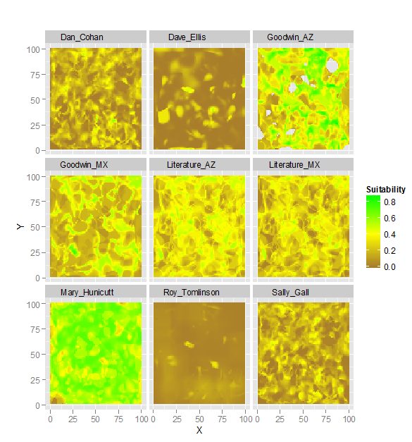
Results: Habitat Simulations

Slide 41
Results: Habitat Simulations
Scores were stable between simulations
Models differed in discriminatory ability
Models with components measured at large scales had low variance
Literature model had the lowest discrimination

Slide 42
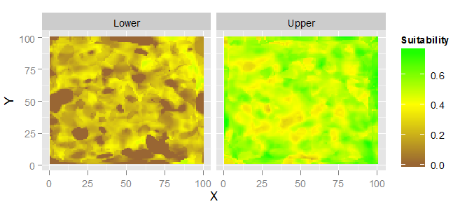
Results: Habitat Simulations
Calculated upper and lower confidence intervals for overall HSI score
Lower limit can be used as a conservative estimate of suitability

Slide 43
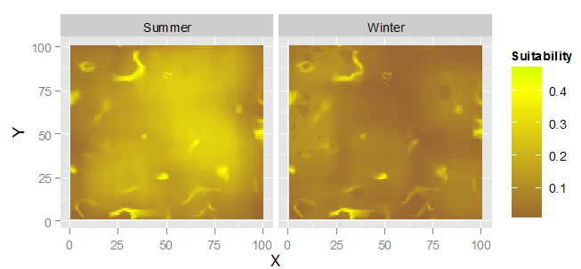
Results: Habitat Simulations
Demonstrated the utility of models for habitat management
Can use models to identify limiting habitat components

Slide 44
Next Steps
Use estimates of uncertainty to target research
Use lower confidence limit to identify best areas for release
Use models to determine most limiting habitat components
Conduct experiments using marked release birds to test HSI model hypotheses

Slide 45
Questions and Feedback?

